Slide 1
Article Name :
Alirocumab and Cardiovascular Outcomes after Acute Coronary Syndrome
Author: Schwartz, et. al
Journal: The new England journal of medicine
Published on: November 29th, 2018
Pharmacotherapy I

Slide 2
Background information
  Patients who have had an acute coronary syndrome are at high risk for recurrent ischemic cardiovascular events. We sought to determine whether alirocumab, a human monoclonal antibody to proprotein convertase subtilisin–kexin type 9 (PCSK9), would improve cardiovascular outcomes after an acute coronary syndrome in patients receiving high-intensity statin therapy.
  Despite the availability of currentevidence-based treatments, patients who have had an acute coronary syndrome remain at high risk for recurrent ischemic cardiovascular events.1,2 This residual risk is attributable in part to elevated levels of low-density lipoprotein (LDL) cholesterol and other atherogenic lipoproteins.

Slide 3
EvoProprotein convertase subtilisin–kexin type 9 (PCSK9) promotes degradation of LDL receptorslocumab is PCSK9 inhibitor that lowers LDL-Cholesterol by 60%
Thereby diminishing the clearance of LDL from the circulation

Slide 4
Objective:
The primary end point was a composite of death from coronary heart disease, nonfatal myocardial infarction, fatal or nonfatal ischemic stroke, or unstable angina requiring hospitalization
Design:
During a prerandomization run-in phase (described in the Supplementary Appendix), patients received instruction in injecting themselves (with placebo), and lipid levels were verified for patient eligibility.
Patients who met trial entry criteria were randomly assigned, in a 1:1 ratio, to receive alirocumab at a dose of 75 mg or matching placebo; randomization was stratified according to country (Table S1 in the Supplementary Appendix). All doses of alirocumab or placebo were administered by subcutaneous injection every 2 weeks

Slide 5
Length of Study
Randomization on the month of November 2018
The median duration of follow-up was 2.8 years
All efficacy analysis were conducted on an intention-to-treat basis

Slide 6
Outcomes
  Primary end point: composite of death from coronary heart disease, nonfatal myocardial infarction, fatal or nonfatal ischemic stroke, or unstable angina requiring hospitalization.
  Key secondary end point:a
  Safety was assessed through collection of data on adverse events and central laboratory testing.
  A central clinical-events committee, whose members were unaware of study-group assignments and cholesterol level, determined all potential efficacy end-point events and cases of new-onset diabetes.

Slide 7
Interventions
  Patients were randomly assigned to receive alirocumab subcutaneously at a dose of 75 mg (9462 patients) or matching placebo (9462 patients) every 2 weeks. The dose of alirocumab was adjusted under blinded conditions to target an LDL cholesterol level of 25 to 50 mg per deciliter (0.6 to 1.3 mmol per liter).
  Monitoring of adherence not specified

Slide 8
Method
Patients were eligible for enrollment in the trial if they were 40 years of age or older, underwent randomization. A total of 18,924 patients underwent randomization at 1315 sites in 57 countries; 9462 were assigned to the alirocumab group and 9462 to the placebo group
Patients had been hospitalized with an acute coronary syndrome (myocardial infarction or unstable angina) 1 to 12 months before randomization, and had an LDL cholesterol level of at least 70 mg per deciliter (1.8 mmol per liter), a non−high-density lipoprotein (HDL) cholesterol level of at least 100 mg per deciliter, or an apolipoprotein B level of at least 80 mg per deciliter

Slide 9
Exclusion Criteria (ClinicalTrials.gov) | Inclusion Criteria
NYHA class III or IV, or last known LVEF < 30% Uncontrolled hypertension Uncontrolled or recurrent ventricular tachycardia Untreated hyperthyroidism or hypothyroidism Homozygous familial hypercholesterolemia | Age 40 years plus Clinical ASCVD - Myocardial infarction, nonhemorrhagic stroke, or symptomatic peripheral artery disease. LDL cholesterol level of at least 70 mg per deciliter (1.8 mmol per liter), a non−high-density lipoprotein (HDL) cholesterol level of at least 100 mg per deciliter, or an apolipoprotein B level of at least 80 mg per deciliter

Slide 10
Statistical Analysis
Design assumptions included an incidence of the composite primary end point of 11.4% at 4 years in the placebo group and a median baseline LDL cholesterol level of 90 mg per deciliter (2.3 mmol per liter), with an anticipated 50% lower LDL cholesterol level in the alirocumab group than in the placebo group, which would result in an expected 15% lower risk of the primary end point with alirocumab than with placebo.
It was estimated that 1613 composite primary end-point events occurring in 18,000 patients over a median follow-up of approximately 3 years would provide the trial with 90% power to detect the expected difference in risk at a significance level of 0.05.
Notes:
The Cox proportional-hazards model (Cox, 1972) is essentially a regression model commonly used statistical in medical research for investigating the association between the survival time of patients and one or more predictor variables
In statistics, the log-rank test is a hypothesis test to compare the survival distributions of two samples. It is a nonparametric test and appropriate to use when the data are right skewed and censored.

Slide 11

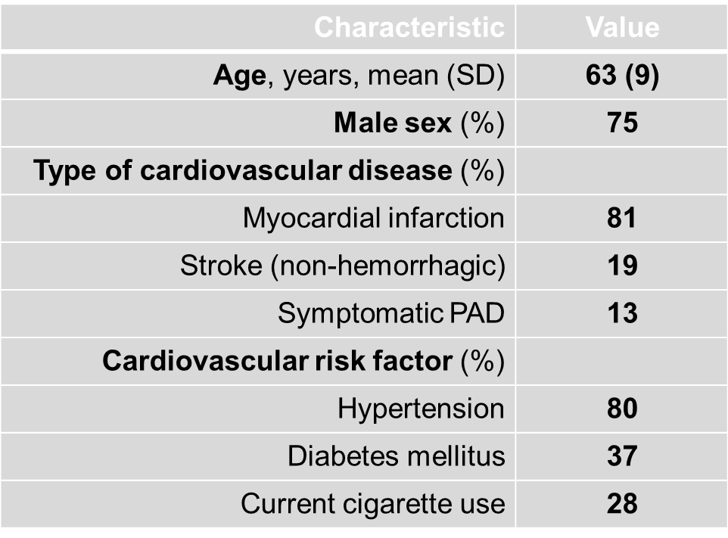
Baseline Characteristics (N=18,924 [Evolocumab N=1,315 and Placebo N=9,462])
  Demographics
    A total of 18,924 patients underwent randomization at 1315 sites in 57 countries; 9462 were assigned to the alirocumab group and 9462 to the placebo group
  Region
    China
  Type of atherosclerosis (history)
  LDL cholesterol level of 70 mg or more per deciliter
  Cardiovascular risk factors
    The qualifying acute coronary syndrome was myocardial infarction in 83.0% of the patients and unstable angina in 16.8%.

Slide 12
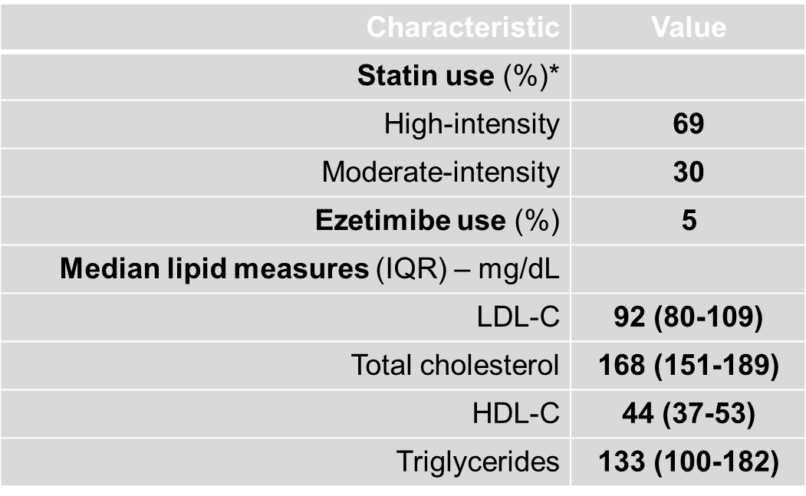
  Statin use
    88.8% of the patients were receiving atorvastatin at a dose of 40 mg to 80 mg daily or were receiving rosuvastatin at a dose of 20 mg to 40 mg daily
    LDL cholesterol was evaluated in an intention-to-treat analysis that included levels measured after premature discontinuation of the trial regimen, levels measured after dose adjustments were made under blinded conditions, and levels measured after blinded substitution of placebo for alirocumab

Slide 13
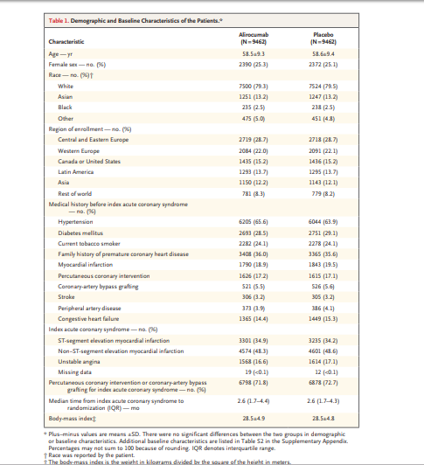

Slide 14
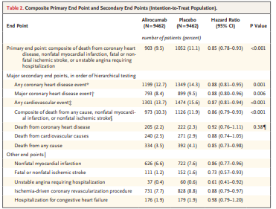
Results: Primary and secondary efficacy endpoint

Slide 15
Adverse Events
The intention-to-treat analysis (results shown with solid lines) included all low-density lipoprotein (LDL) cholesterol values, including levels measured after premature discontinuation of the trial regimen, levels measured after dose adjustments were made under blinded conditions, and levels measured after blinded substitution of placebo for alirocumab.
The on-treatment analysis (results shown with dashed lines) excluded LDL cholesterol levels measured after premature discontinuation of the trial regimen and levels measured after blinded substitution of placebo for alirocumab (but included LDL cholesterol levels measured after dose adjustments of alirocumab were made under blinded conditions between the 75-mg dose and the 150-mg dose).

Slide 16
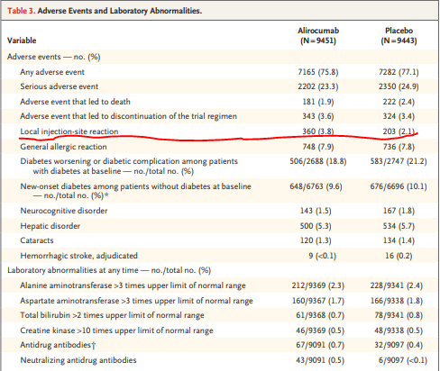

Slide 17
Discussion & Conclusion
The incidence of adverse events and of laboratory abnormalities was similar in the alirocumab group and the placebo group, with the exception of local injection-site reaction (3.8% in the alirocumab group vs. 2.1% in the placebo group, P<0.001).
Injection-site reactions (itching, redness, or swelling) were usually mild and selflimited and led to discontinuation of the trial regimen in 26 patients in the alirocumab group,at a median of 8.3 months after randomization, and in 3 patients in the placebo group.
Neurocognitive events were reported in 1.5% of the patients in the alirocumab group and in 1.8% of

Slide 18

Journal
Journal of the New England Journal of Medicine (NEJM)
Impact factor 2018/2019
79.258

Slide 19
Critical Appraisal
Background and Rationale: Satisfactory
The background is presented appropriately and it is justified by the author as he mentioned that Evolocumab also lowers low-density lipoprotein (LDL) cholesterol levels by sixty percent
Previous trials
previous trials of more intensive LDL cholesterol–lowering therapy as compared with moderate-intensity statin therapy, it was found that there was no effect of additional lowering of LDL cholesterol levels on cardiovascular mortality.
The rate of use of evidence-based cardiovascular pharmacotherapies that lower cardiovascular mortality was very high in FOURIER,
Objectives: Satisfactory
The objective of the study was stated clearly about the FOURIER trial tested the clinical efficacy and safety of Evolocumab when added to high-intensity or moderate-intensity statin therapy in patients with clinical ASCVD

Slide 20
Control of Treatment-Related Bias: Satisfactory
The study was double blinded
The drugs, doses , regimen, and time of administration was clearly mentioned and outlined
patients were randomly assigned in a 1:1 ratio to receive subcutaneous injections of evolocumab
Random assignment done through computer generated random numbers
Description of the Study: Satisfactory
Among patients who had a previous acute coronary syndrome and whose levels of atherogenic lipoproteins remained elevated despite statin therapy at a high-intensity dose or at the maximum tolerated dose, the risk of major adverse cardiovascular events was lower among those who were treated with alirocumab than among those who received placebo.

Slide 21
Statistical analysis: Satisfactory
The primary analysis of the data was done with treating the population which reflects the real clinical population
The study used effective and Appropriate statistical tests to analyze the data
Synthesis of Data: Satisfactory
The study approach used to answer the research question and prove the hypothesis was concise and clear
All results of the study were clearly presented on graphs and tables and they were easy to follow and comprehend
Focus of the study: Satisfactory
The author stated the conclusion clearly and was related to the research question of the study
Application of the study
The study has was sufficiently presented this means the sample size is adequate to represent the population, however the following limitations were noted:
  Short duration of follow-up
    Limits evaluation of long term benefits of Evolocumab.
  Potential for bias due to manufacturer/sponsor (Amgen) of Evolocumab (Rapatha).
  Baseline characteristics were slightly skewed. (Mostly male and white)Weakens external validity

Slide 22
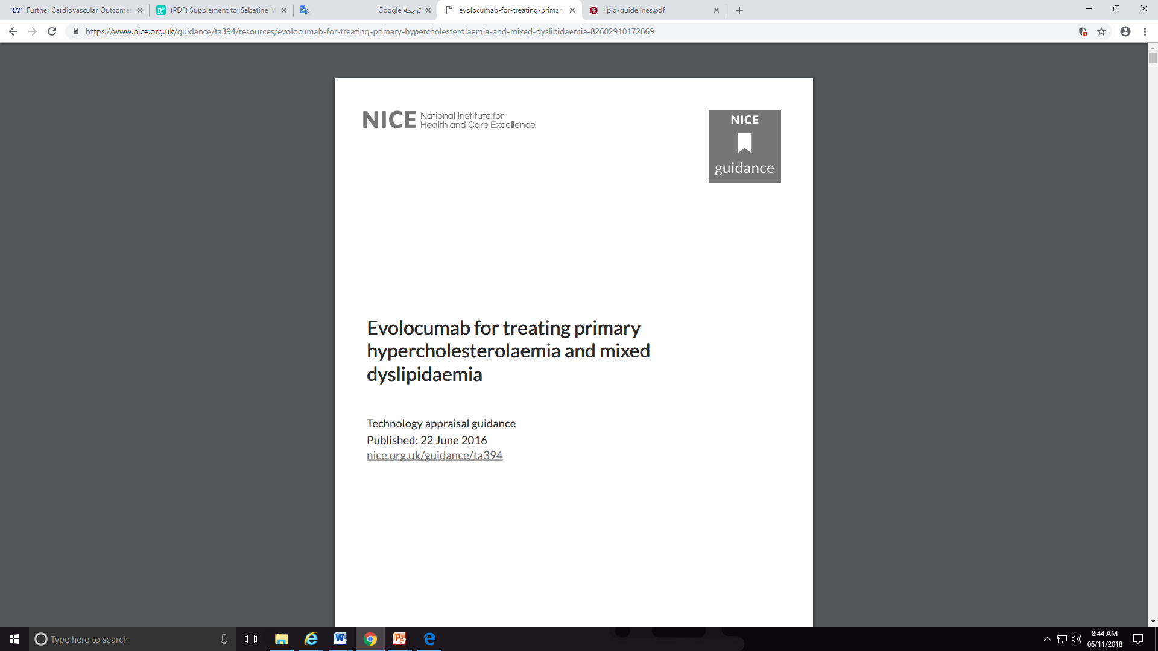
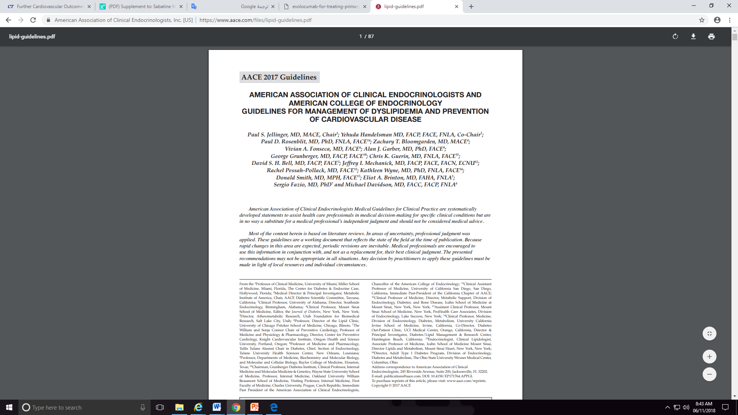

Slide 23
THANK YOU

